Slide 1
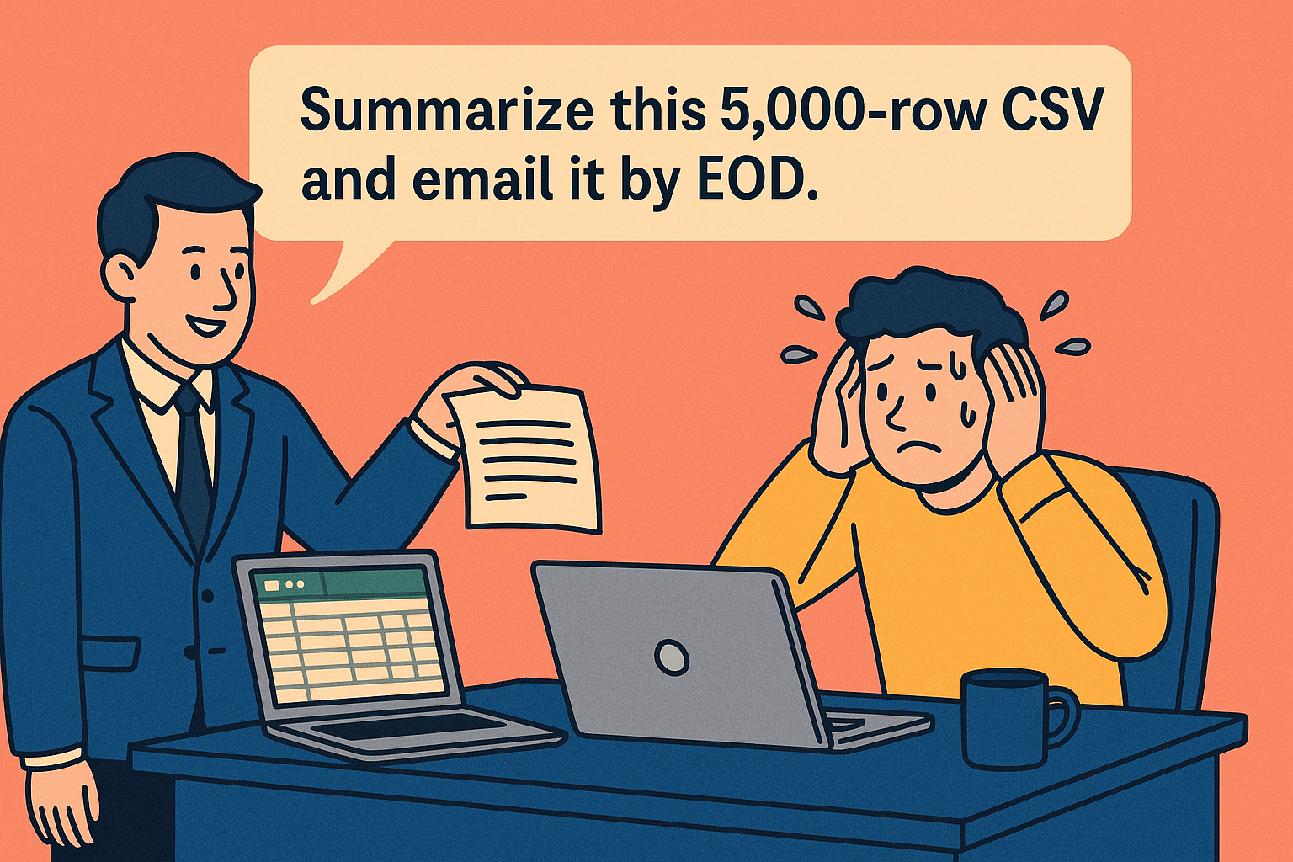

Slide 2
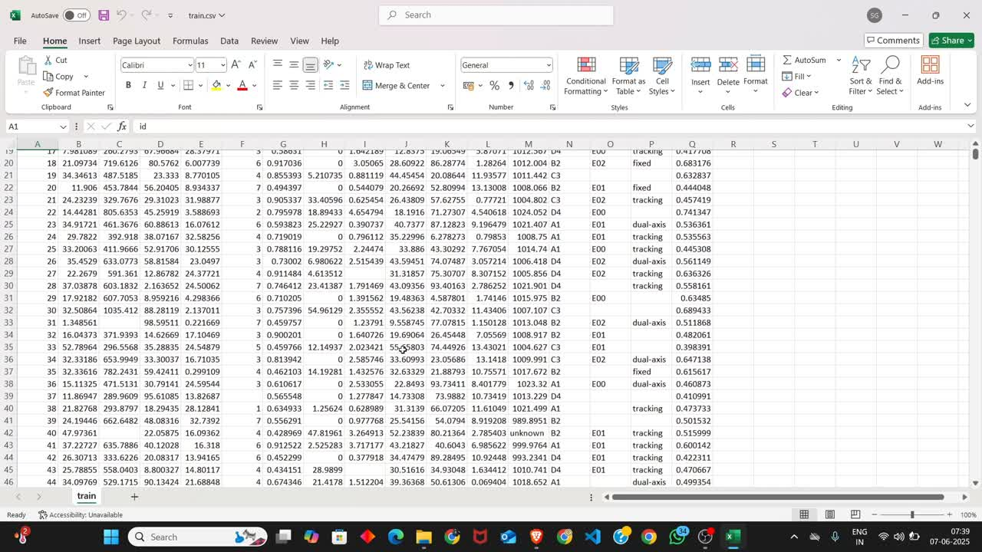

Slide 3
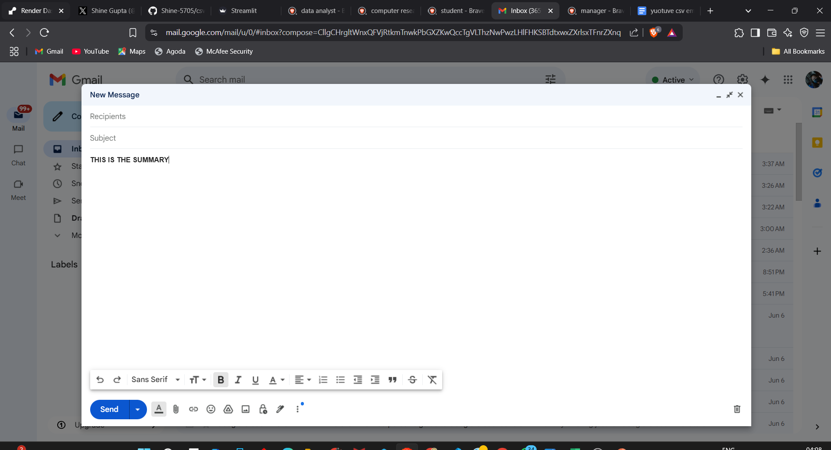

Slide 4



Slide 5
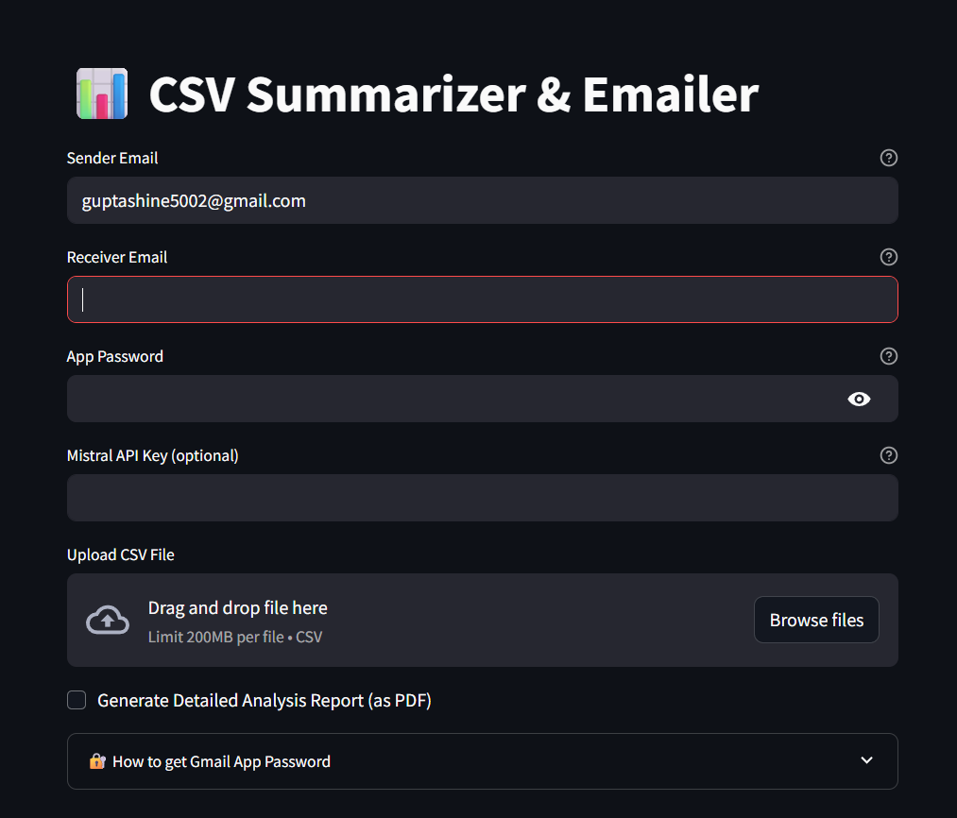

Slide 6


Lets Say,
I am SHINE!
Marketing Analyst…

Slide 7

Get CSV with campaign metrics every week...

Slide 9
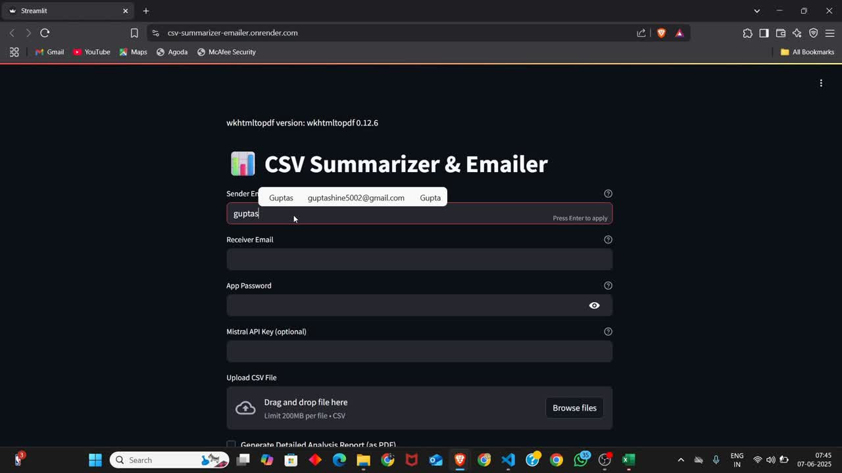

Slide 10
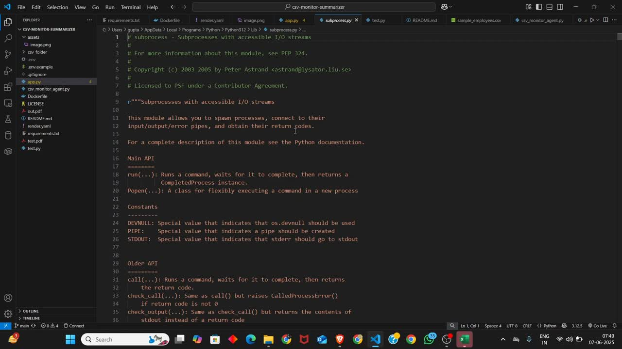

Slide 11
Github : https://github.com/Shine-5705/csv-monitor-summarizer
Or — if you don’t want to install anything — just use our free live version at:
🌐 https://csv-summarizer-emailer.onrender.com

Slide 12

So,
who’s this for?

Slide 13

If you’re a data analyst tired of writing manual summaries!

Slide 14


A manager who needs weekly updates formatted and sent fast...

Slide 15


A researcher or student collaborating with others on datasets...

Slide 16

This tool will save you
hours
+
its OPEN SOURCE

Slide 17

So next time you’re handed a CSV file, don’t open Excel. Open this app: https://csv-summarizer-emailer.onrender.com/
Let AI do the heavy lifting, and send out a perfect report in seconds.
The code’s on GitHub: https://github.com/Shine-5705/csv-monitor-summarizer.

Slide 18


